Slide 1
Central Processing Unit Design
Reporter: Jyun-Xin Ke

Slide 2
Outline
Introduction
Add R-type instruction
Add I-type instruction
Add J-type instruction
Conclusion

Slide 3
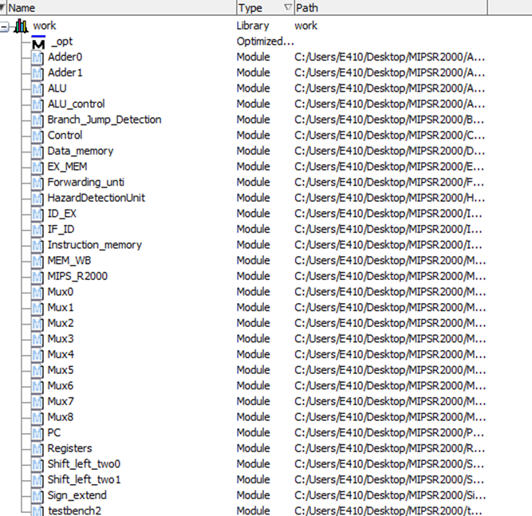
Introduction
MIPS R2000

Slide 4
Introduction
Data Memory
assign Read_data[31:24] = (MemRead[0])? memory3[Address] : 8'd0;
assign Read_data[23:16] = (MemRead[0])? memory2[Address] : 8'd0;
assign Read_data[15:8] = (MemRead[0])? memory1[Address] : 8'd0;
assign Read_data[7:0] = memory0[Address] ;
Memory 0 | Memory 1 | Memory 2 | Memory 3
address 0 | address 0 | address 0 | address 0
address 1 | address 1 | address 1 | address 1
address 2 | address 2 | address 2 | address 2

Slide 5
Add R-type instruction
R-type
Instruction OP/funct Meaning
add $rd, $rs, $rt 0/32 $rd = $rs + $rt
sub $rd, $rs, $rt 0/34 $rd = $rs - $rt
and $rd, $rs, $rt 0/36 $rd = $rs & $rt
or $rd, $rs, $rt 0/37 $rd = $rs | $rt
slt $rd, $rs, $rt 0/42 if($rs<$rt) $rd =1; else $rd = 0
sll $rd, $rt, shamt 0/0 $rd = $rt << shamt
srl $rd, $rt, shamt 0/2 $rd = $rt >> shamt
sra $rd, $rt, shamt 0/3 $rd = $rt >> shamt(signed)
Mfc0 $rt, EPC 16 $rt = EPC
Jr $rs 0/8 PC = $rs
000000
Source Register
Target Register
目的地暫存器
位移之位數
精確定義指令類型
opcode (6) | rs (5) | rt (5) | rd (5) | shamt (5) | function (6)

Slide 6
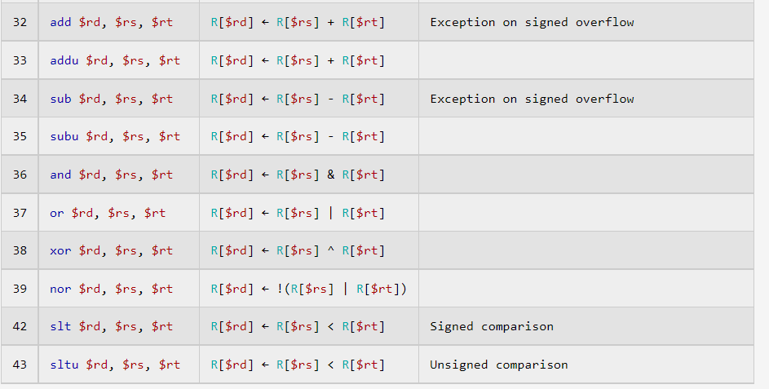
Add R-type instruction
XOR NOR

Slide 7
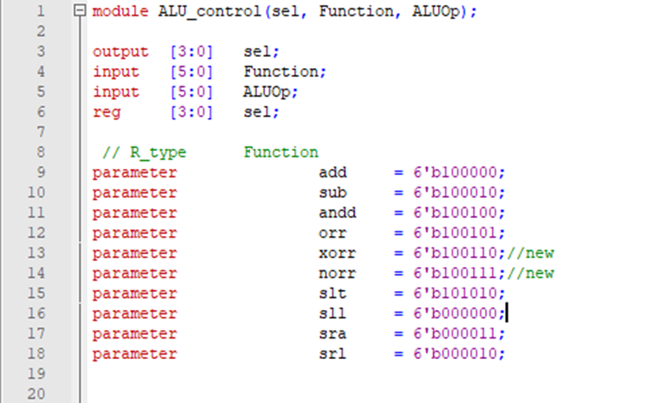
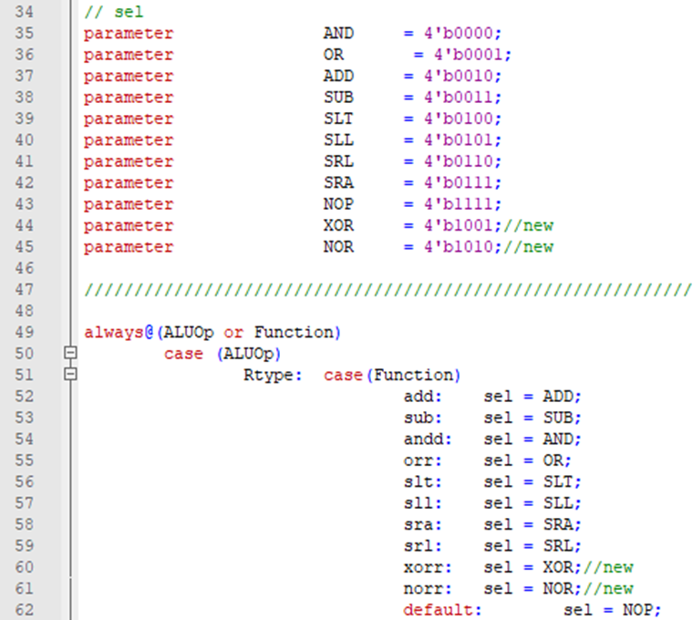
Add R-type instruction
XOR NOR (ALU-Control)

Slide 8
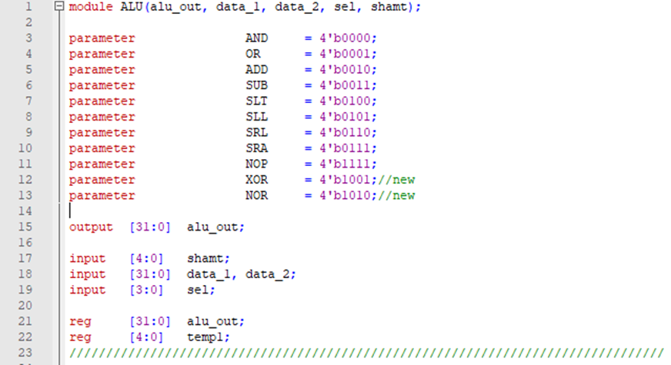
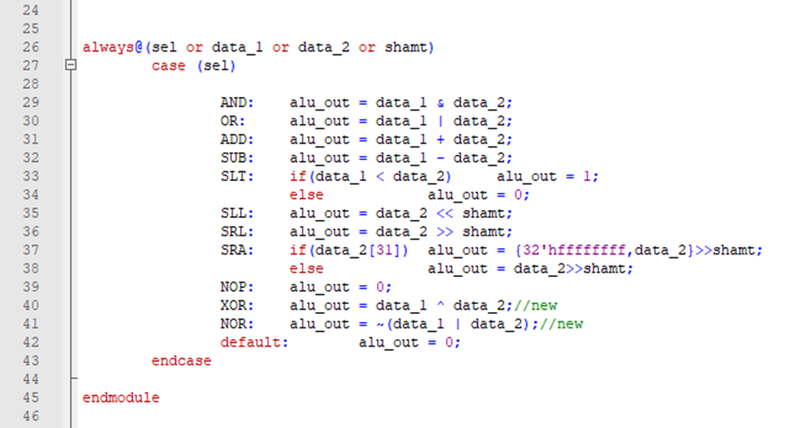
Add R-type instruction
XOR NOR (ALU)

Slide 9
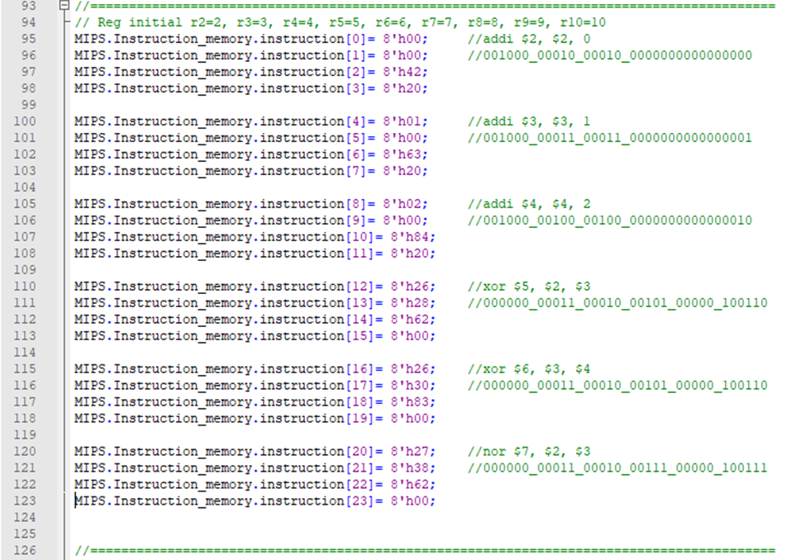
Add R-type instruction
XOR NOR (Testbench)

Slide 10
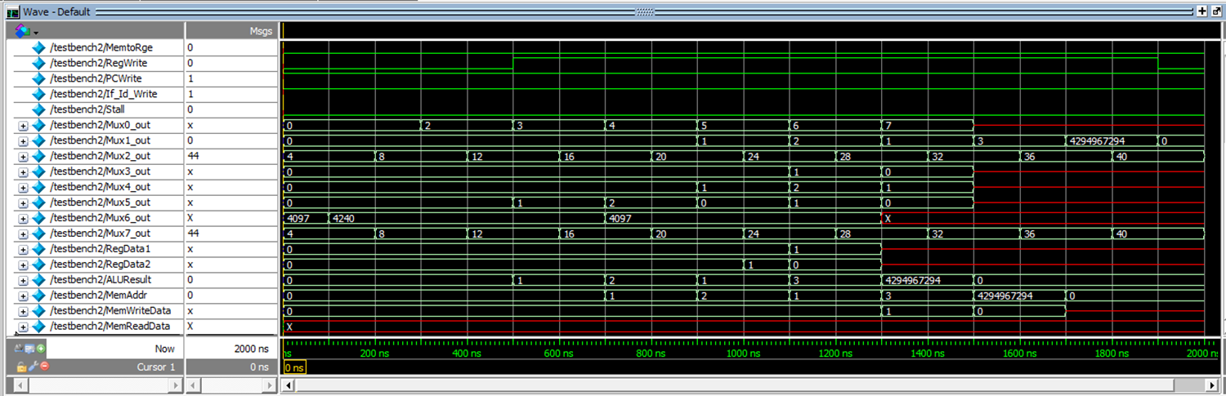
Add R-type instruction
XOR NOR (Testbench)

Slide 11
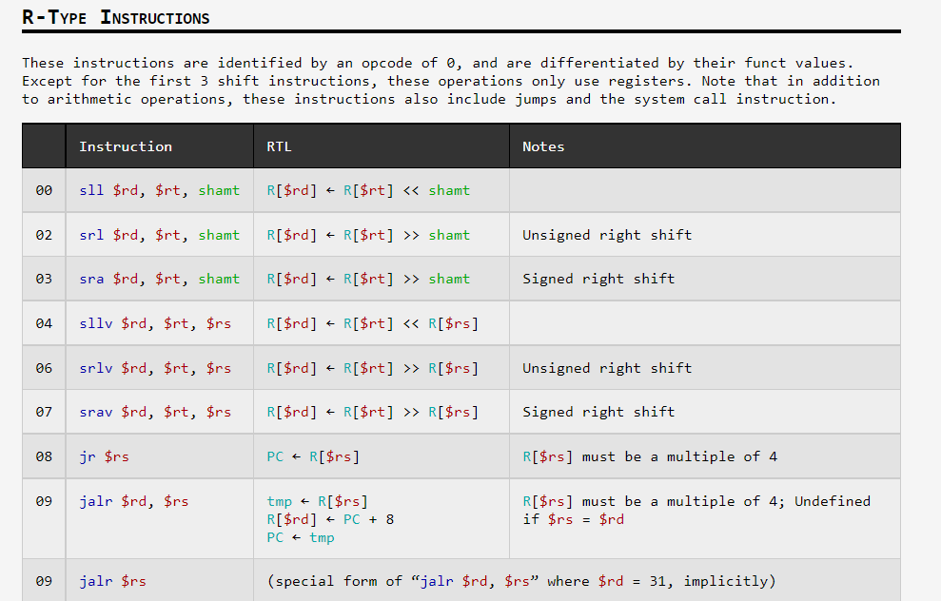
Add R-type instruction
SLLV SRLV SRAV

Slide 12
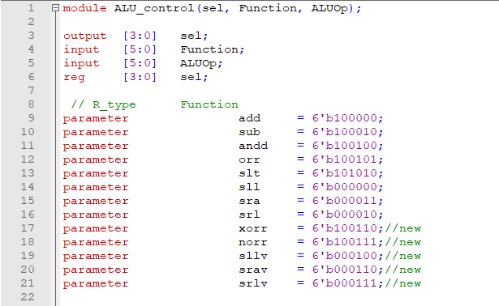
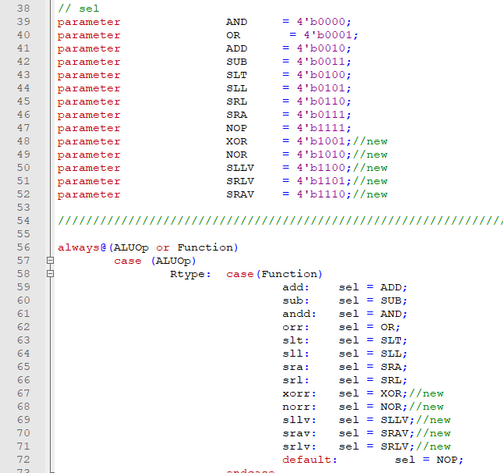
Add R-type instruction
SLLV SRLV SRAV(ALU-Control)

Slide 13
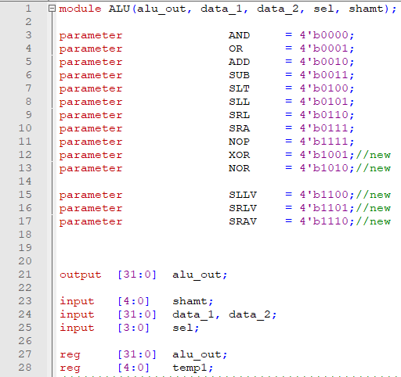
Add R-type instruction
SLLV SRLV SRAV(ALU)

Slide 14
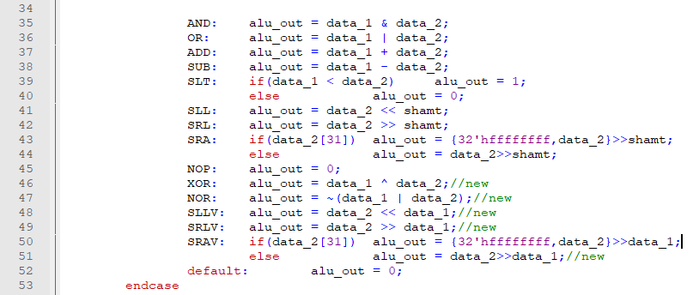
Add R-type instruction
SLLV SRLV SRAV(ALU)

Slide 15
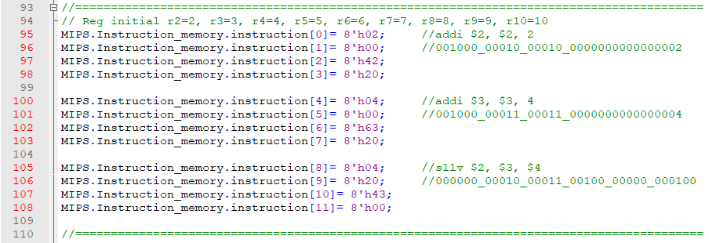
Add R-type instruction
SLLV (Testbench)

Slide 16
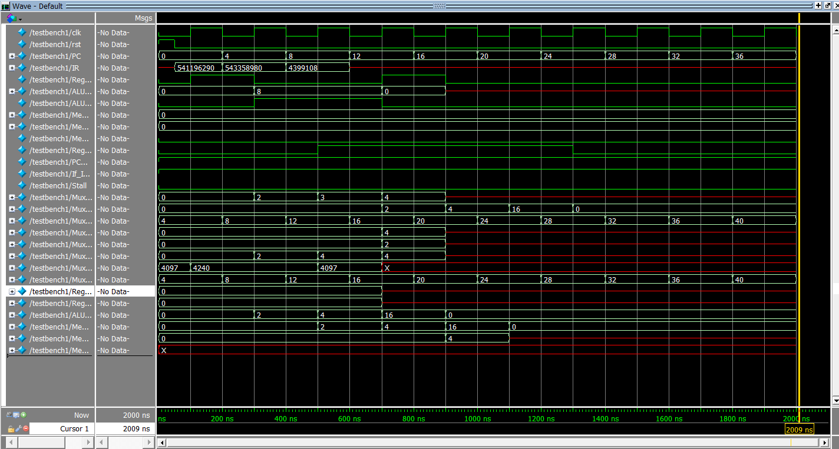
Add R-type instruction
SLLV (Testbench)
把4往左移2位為16

Slide 17
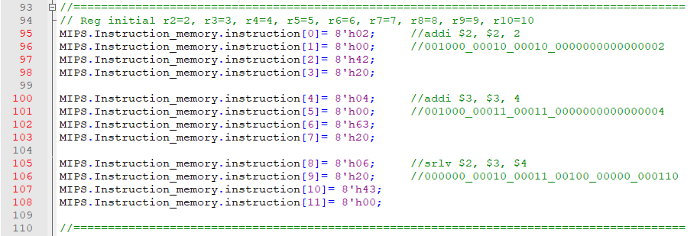
Add R-type instruction
SRLV (Testbench)

Slide 18
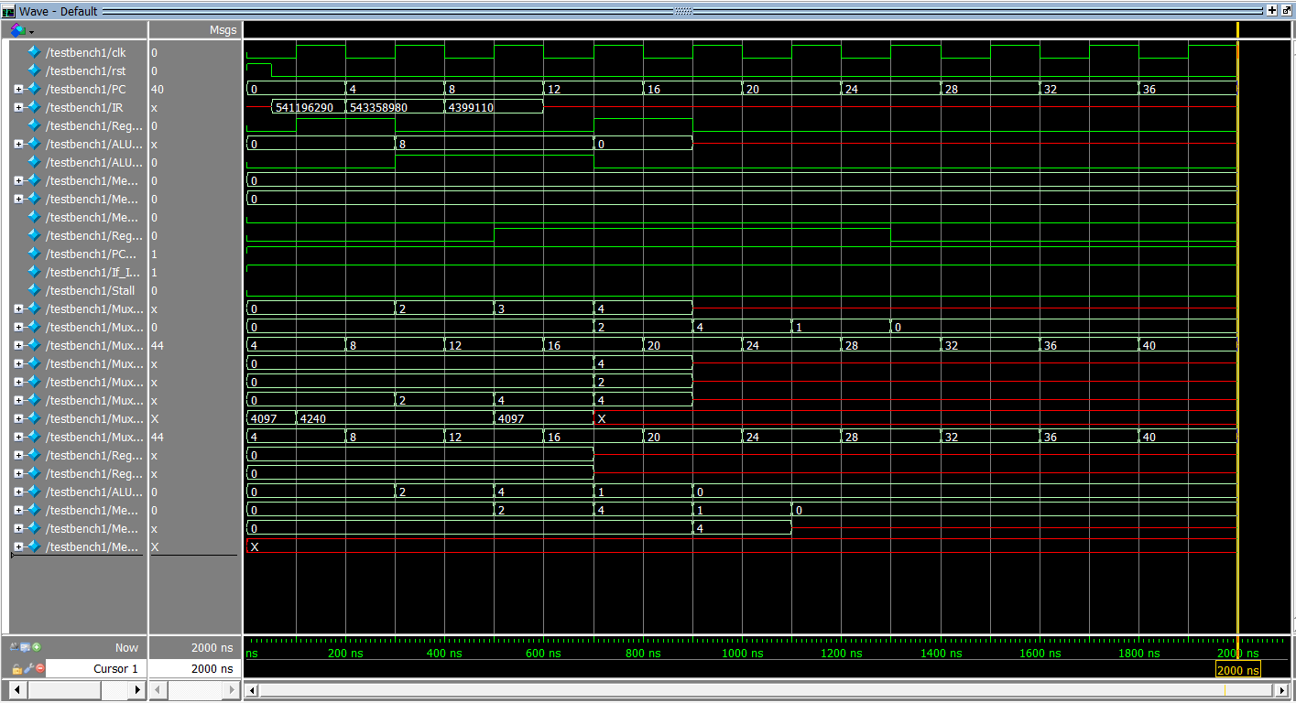
Add R-type instruction
SRLV (Testbench)
把4往右移2位為1

Slide 19
Add I-type instruction
I-type
Instruction OP Meaning
addi $rt, $rs, immediate 8 $rt = $rs + imm
andi $rt, $rs, immediate 12 $rt = $rs & imm
ori $rt, $rs, immediate 13 $rt = $rs | imm
slti $rt, $rs, immediate 10 if($rs<imm) $rt=1; else $rt=0
lw $rt, immediate($rs) 35 $rt = M[$rs + imm] (word)
lb $rt, immediate($rs) 32 $rt = M[$rs + imm] (byte)
sw $rt, immediate($rs) 43 M[$rs + imm] = $rt (word)
sb $rt, immediate($rs) 4 M[$rs + imm] = $rt (byte)
beq $rs, $rt, immediate 4 if($rs==$rt) PC = PC+imm
ben $rs, $rt, immediate 5 if($rs!=$rt) PC = PC+imm
opcode (6) | rs (5) | rt (5) | immediate (16)

Slide 20
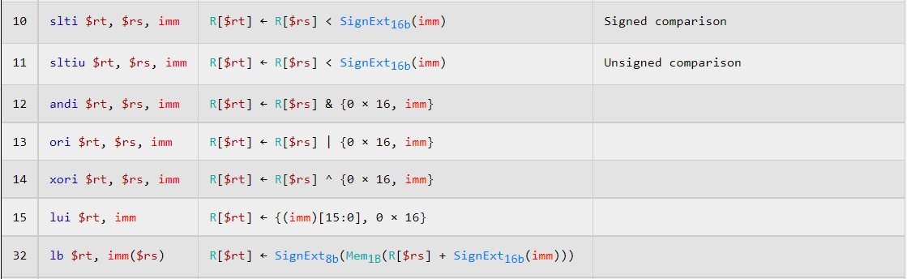
Add I-type instruction
XORI

Slide 21
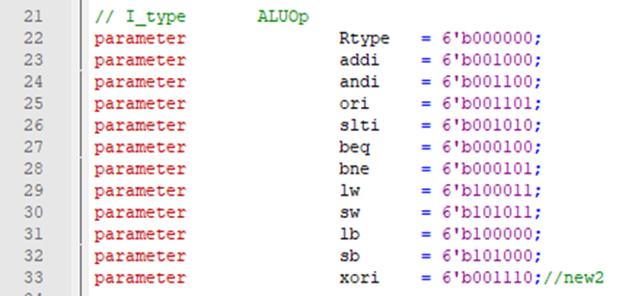
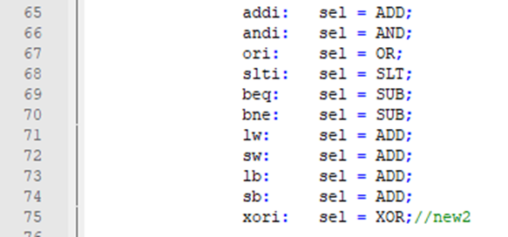
Add I-type instruction
XORI (ALU_Control)

Slide 22
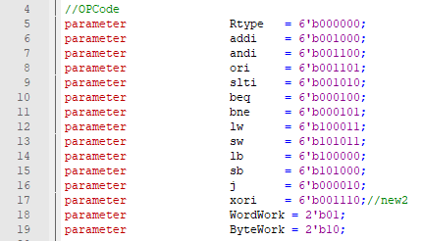
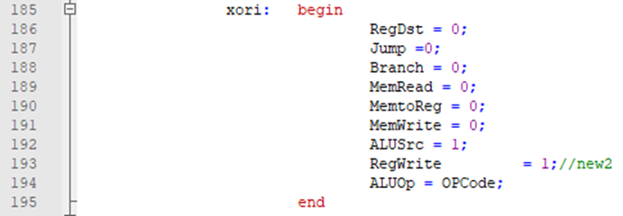
Add I-type instruction
XORI (Control)
ALUsrc:1是用sign-extend 立即值、0是用register的值（ALU source)

Slide 23
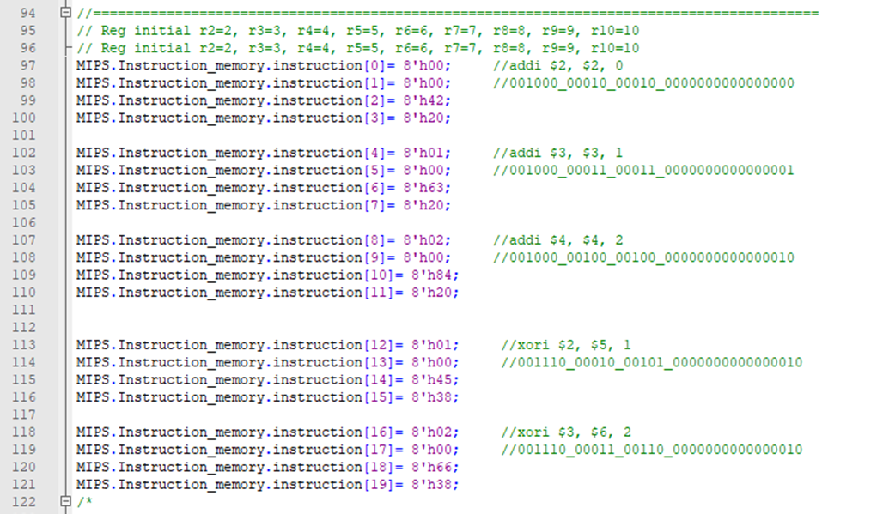
Add I-type instruction
XORI (Testbench)

Slide 24
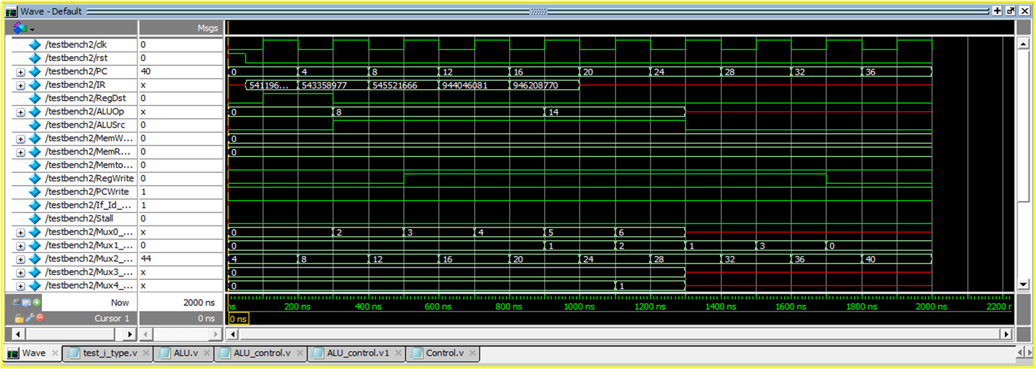
Add I-type instruction
XORI (Testbench)

Slide 25
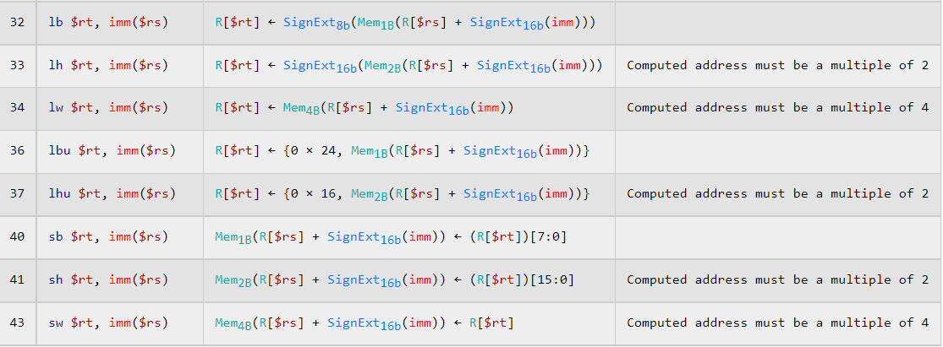
Add I-type instruction
LH SH

Slide 26
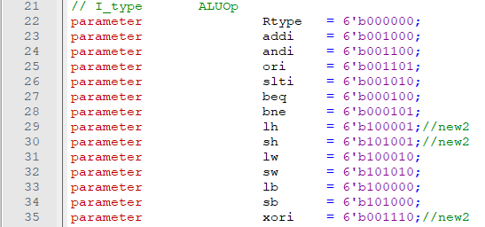
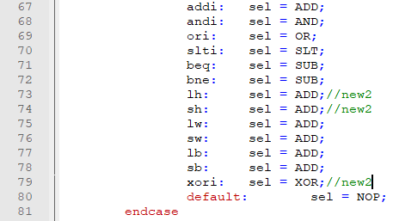
Add I-type instruction
LH SH (ALU_Control)

Slide 27
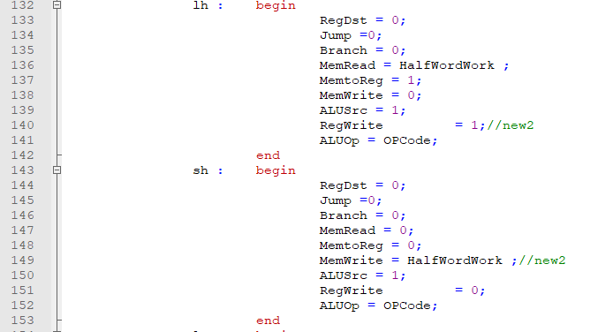
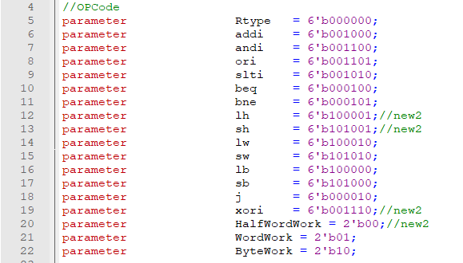
Add I-type instruction
LH SH (Control)

Slide 28
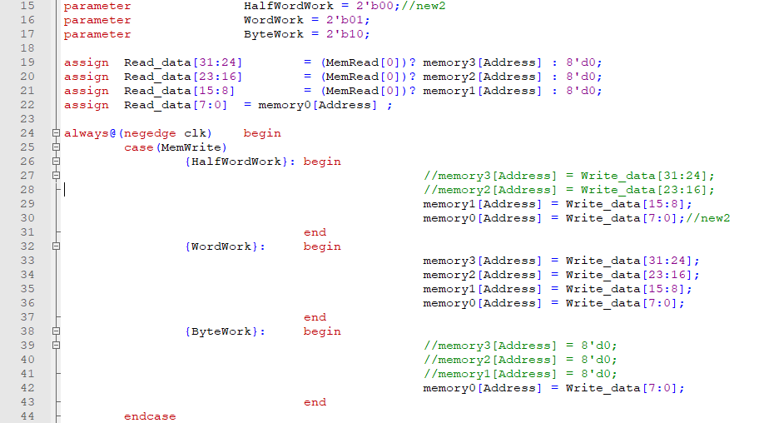
Add I-type instruction
LH SH (Data_memory)

Slide 29
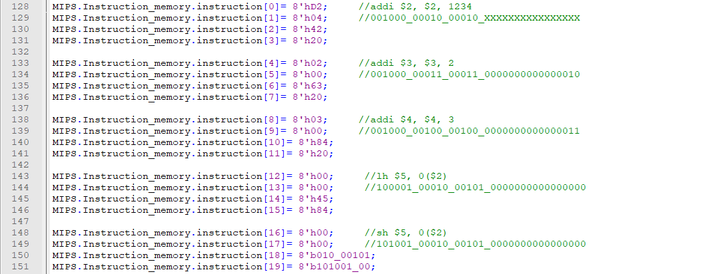
Add I-type instruction
LH SH (Testbench)

Slide 30
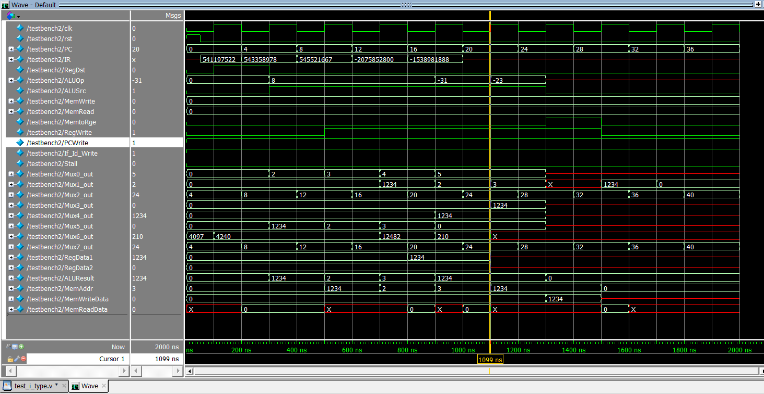
Add I-type instruction
LH SH (Testbench)

Slide 31
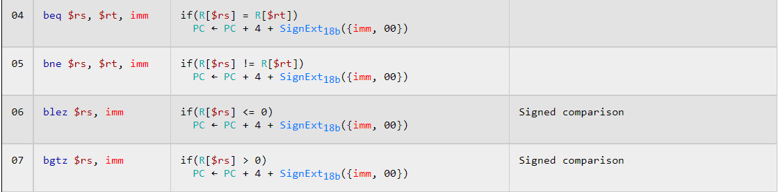
Add I-type instruction
BLE BGT

Slide 32
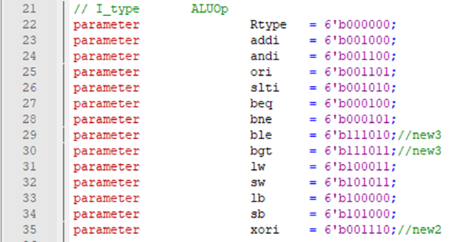
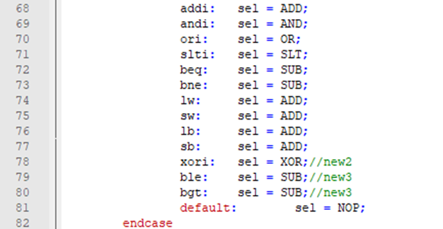
Add I-type instruction
BLE BGT (ALU-Control)

Slide 33
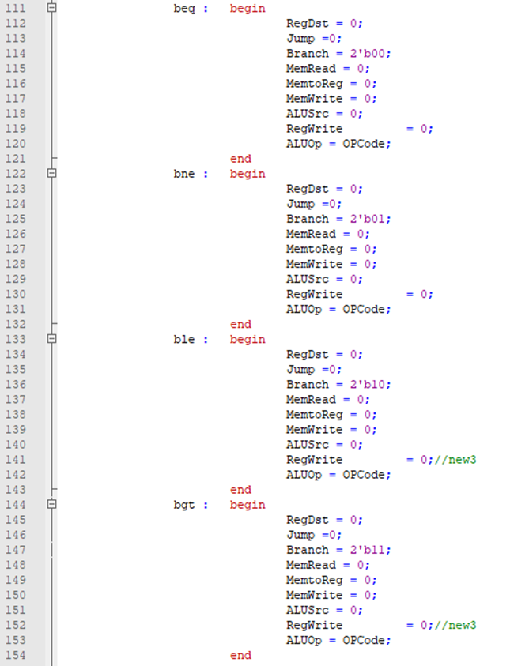
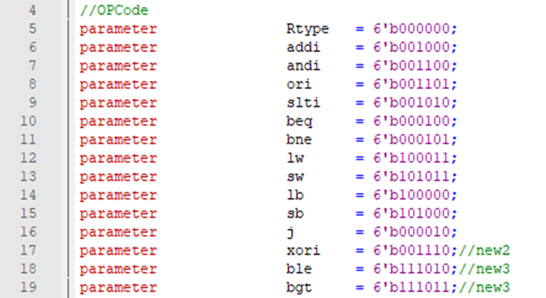
Add I-type instruction
BLE BGT (Control)

Slide 34
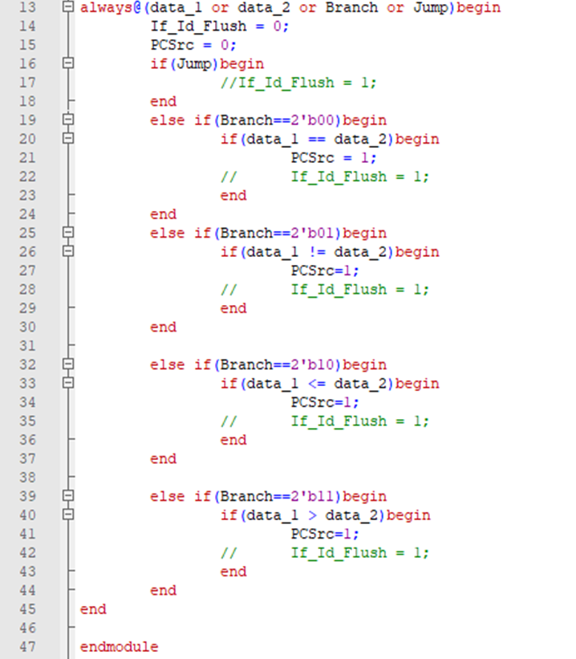
Add I-type instruction
BLE BGT (Branch_Jump)

Slide 35
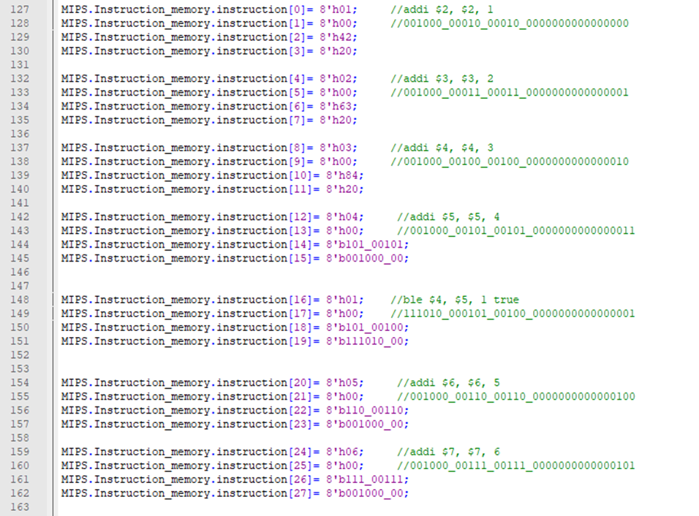
Add I-type instruction
BLE (Testbench)

Slide 36
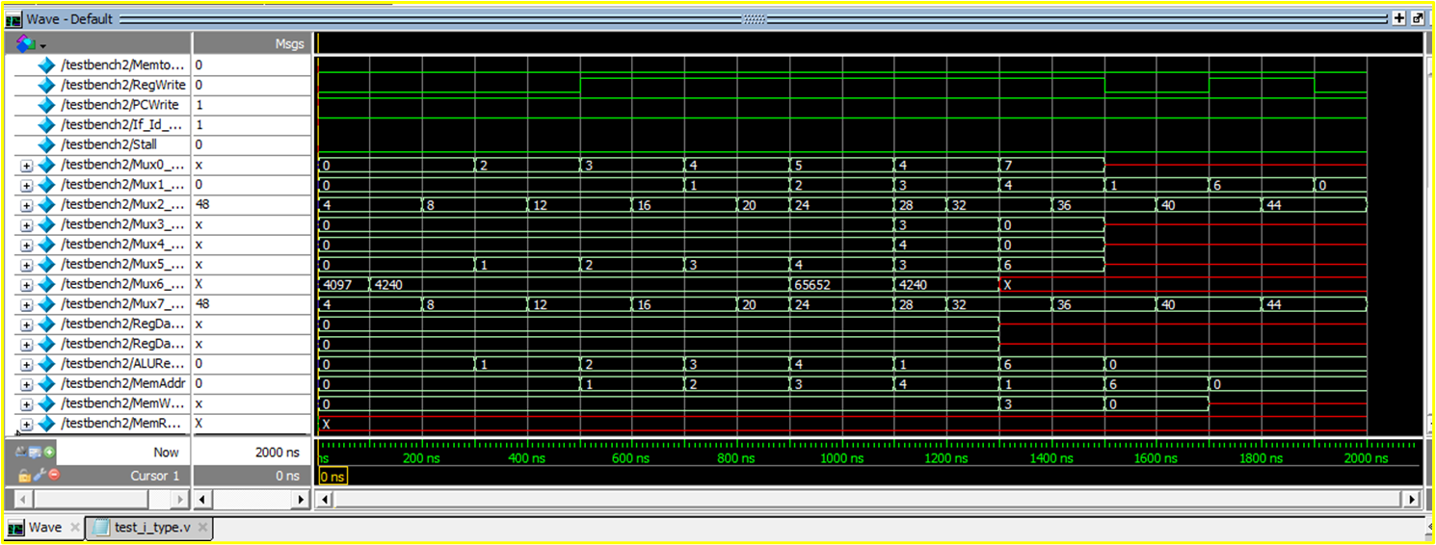
Add I-type instruction
BLE (Testbench)
4 <= 5 條件不成立 Ture，輸出1

Slide 37
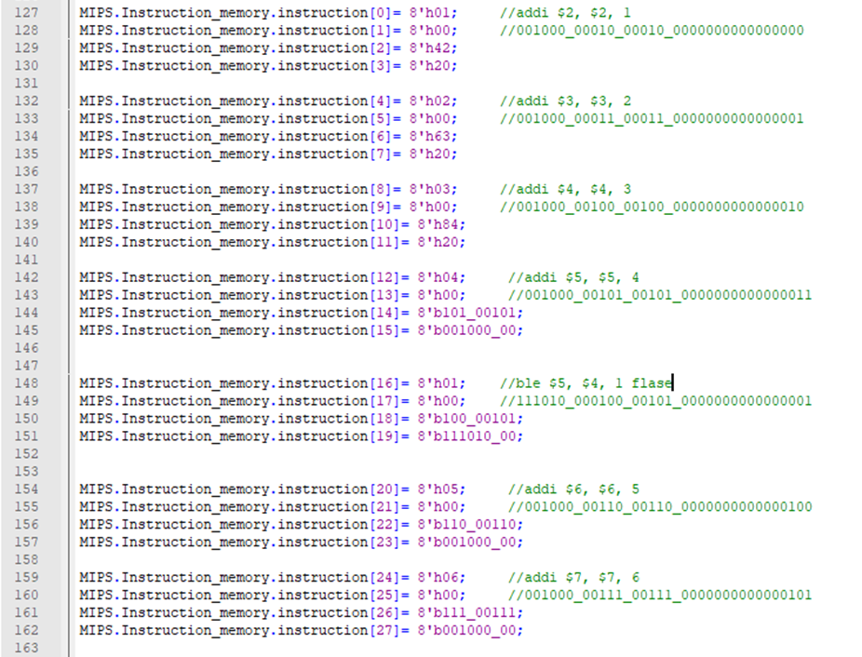
Add I-type instruction
BLE (Testbench)

Slide 38
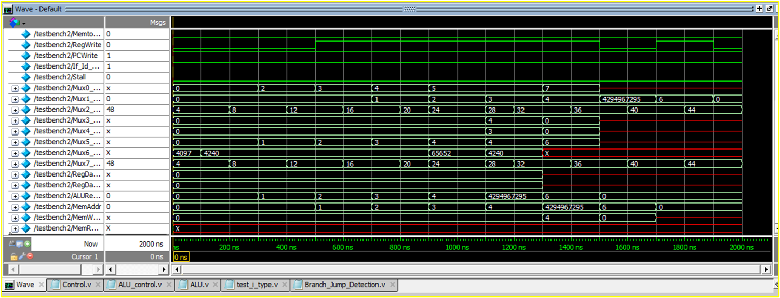
Add I-type instruction
BLE (Testbench)
5 <= 4 條件不成立 Flase，輸出-1

Slide 39
Add J-type instruction
J-type
Instruction OP Meaning
j destination 2 PC = target*4
jal destination 3 $ra = PC; PC = target*4
opcode (6) | Target(26)

Slide 40
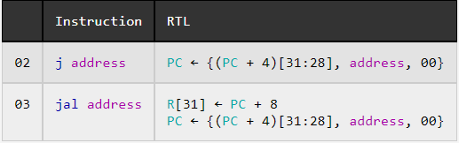
Add J-type instruction
Jal

Slide 41
Add J-type instruction
Jal

Slide 42
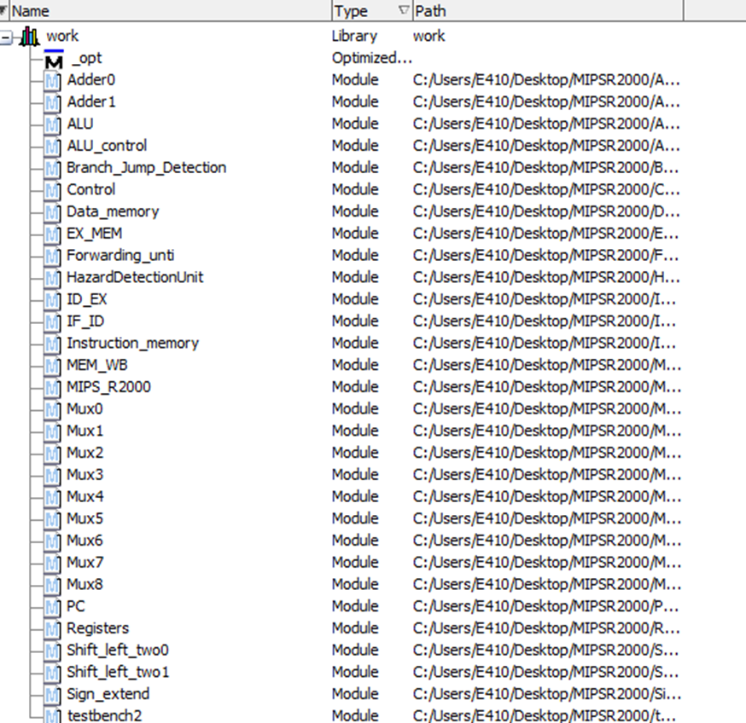
Add J-type instruction
Jal

Slide 43
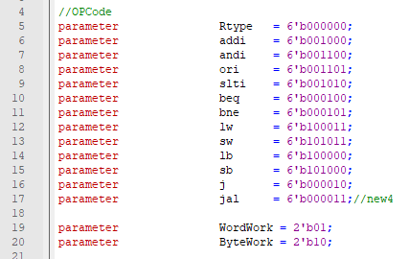
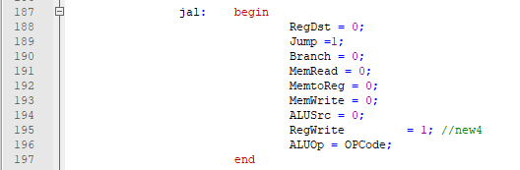
Add J-type instruction
Jal (Control)

Slide 44
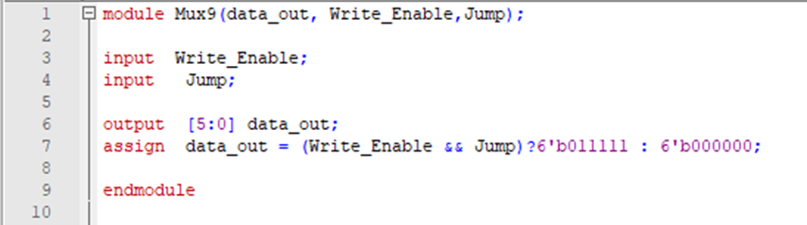

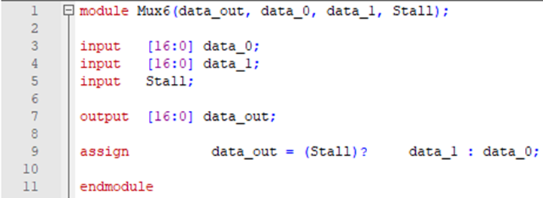
Add J-type instruction
Jal (mux9)

Slide 45
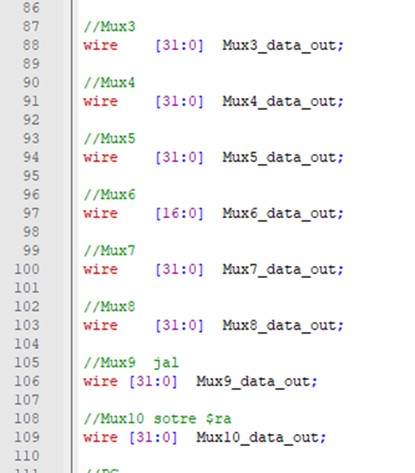
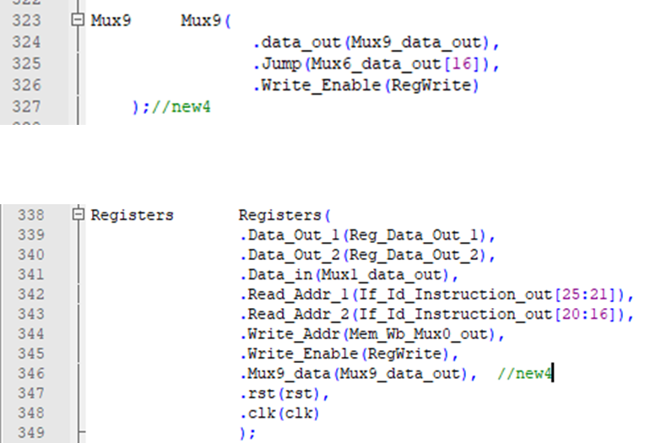
Add J-type instruction
Jal (MIPSR2000)

Slide 46

Add J-type instruction
Jal (reg)

Slide 47

Add J-type instruction
Jal (MIPSR2000)

Slide 48
Conclusion
經歷一個月的分析，我對MIPSR2000更加熟悉，也越來越看的懂光耀學長的寫法了，在修改指令的時候需要考慮十分周到，有時候跑出來的error真的很多，必須很有耐心的一條一條檢查。如果有些程式忘了加，雖然程式會過編譯，但就是不會跑正確的東西出來，這過程發生了應該有二三十次吧，明明只是簡單的指令，但真正要弄懂它卻是要花上足夠的心力才行，反覆地做模擬、修改，一直不斷的嘗試，才能成功新增指令!

Slide 49
Thank you for your attention !

